Slide 1
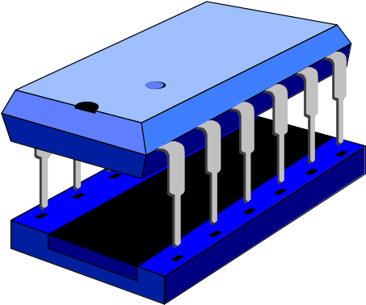
TOY1 Assembly Programming
Professor Kin K. Leung
kin.leung@imperial.ac.uk
www.commsp.ee.ic.ac.uk/~kkleung/
Heavily based on materials by Dr. Naranker Dulay

Slide 2
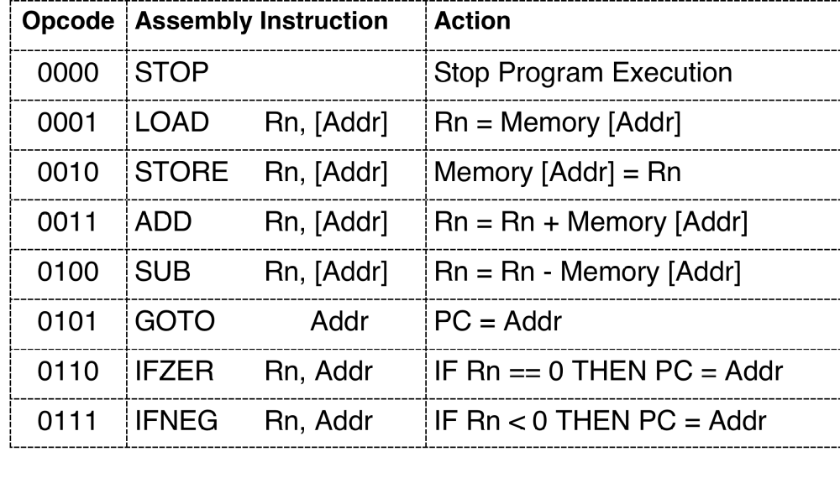
TOY1 Instruction Set

Slide 3
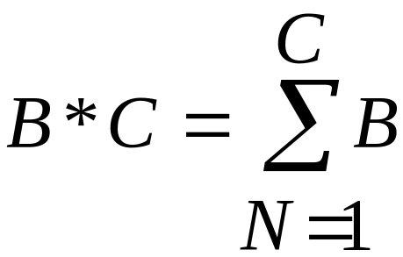
Example 1 - Multiplication
Compute A = B * C
Examples 12 * 3 = 12 + 12 + 12
12 * 1 = 12
12 * 0 = 0

Slide 4
A Solution
; Given: A, B, C
; Pre: C >= 0
; Post: A = B * C
sum = 0 ; accumulate result in sum
n = C ; indicates how many additions remain
loop
exit when n <= 0 ; no more additions remain
sum = sum + B ; add another B
n = n - 1 ; one less addition to do
end loop
A = sum

Slide 5
Variables
We’ll allocate variables to main memory as follows:
A to Memory [ 100H ]
B to Memory [ 101H ]
C to Memory [ 102H ]
sum to R1
n to R2

Slide 6
sum = 0
We need to perform R1 = 0 but the closest instruction we have is LOAD Rn, [Addr]
So we’ll pre-set a memory location (e.g. memory word 200H) to 0.
Now sum = 0 simply translates to
LOAD R1, [200H] ; sum = 0

Slide 7
Memory Contents
We’ll fill main memory as follows:
Address Contents
100H A
101H B
102H C
200H 0
080H 1st Instruction of program
081H 2nd Instruction of program
Etc.

Slide 8
n = C
This is easy to translate LOAD R2, [102H]
We now have
080H LOAD R1, [200H] ; sum = 0
081H LOAD R2, [102H] ; n = C
...
100H A ; holds A
101H B ; holds B
102H C ; holds C
...
200H 0 ; constant 0

Slide 9
exitloop when n <= 0
Let’s consider a simpler statement exitloop when n = 0
Statement Address Instructions
loop
exit when n = 0 IFZER R2,
instructions ... ...
end loop GOTO
.... ....
L0
LY
L0
LY

Slide 10
exit when n <= 0
Statement Address Instructions
loop
exit when n <= 0 IFZER R2,
IFNEG R2,
instructions ... ...
end loop GOTO
.... ....
L0
LY
LY
L0
LY

Slide 11
Memory Contents
080H LOAD R1, [200H] ; sum = 0
081H LOAD R2, [102H] ; n = C
082H IFZER R2, LY ; loop exit when n <= 0
083H IFNEG R2, LY ;
... ... ; ...
... GOTO 082H ; end loop
LY ... ; ...
... ... ; ...
100H A ; holds A
101H B ; holds B
102H C ; holds C
...
200H 0 ; constant 0

Slide 12
sum = sum + B
This simply translates to
ADD R1, [101H]
n = n - 1
This is easy to translate if we pre-set another location (memory word 201H) with the constant 1
SUB R2, [201H]

Slide 13
Final Program
080H LOAD R1, [200H] ; sum = 0
081H LOAD R2, [102H] ; n = C
082H IFZER R2, 087H ; loop exit when n <= 0
083H IFNEG R2, 087H ;
084H ADD R1, [101H] ; sum = sum + B
085H SUB R2, [201H] ; n = n - 1 ...
086H GOTO 082H ; end loop
087H STORE R1, [100H] ; A = sum
088H STOP ; That’s all folks!
100H A ; holds A
101H B ; holds B
102H C ; holds C
200H 0 ; constant 0
201H 1 ; constant 1

Slide 14
Example 2 - Vector Sum
Sum = Memory [200H] + ... + Memory [200H + 99]
sum = 0 ; accumulates result
n = 100 ; no. of elements to add
addr = 200H ; address of 1st element
loop
exit when n <= 0 ; elements remaining
sum = sum + Memory [addr] ; add next element
addr = addr + 1 ; advance to next element
n = n - 1 ; one less element to add
end loop

Slide 15
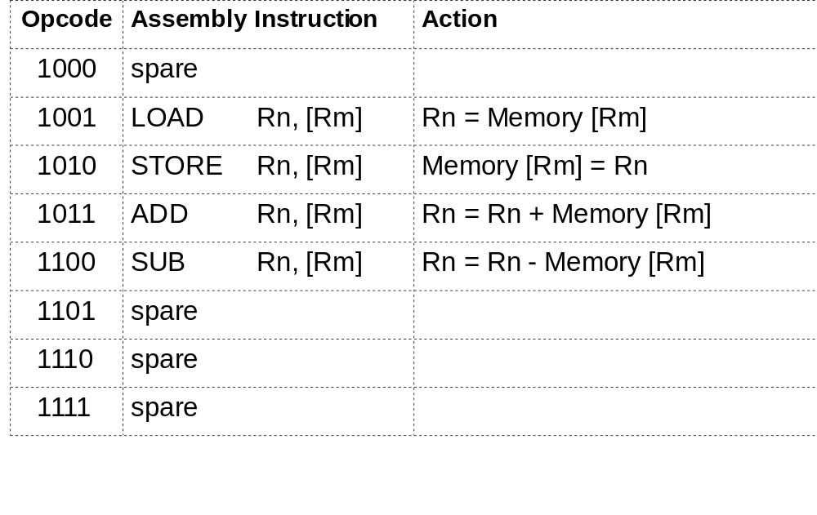
TOY1 Instruction Set Continued

Slide 16
Instruction Format 2
OPCODE
REGn
REGm
UNUSED
4-bit
2-bit
2-bit
8-bit
Example: Disassemble the instruction CEAB H
CEAB = 1100 1110 1010 1011
SUB
R3
[R2]
Unused

Slide 17
Memory Allocation
We’ll allocate variables to memories as follows:
Vector to Memory [ 200H ] .. Memory [ 200H+99]
sum to R0
n to R1
addr to R2
Constants at Memory [ 000H ] onwards
Program at Memory [ 00FH ] onwards

Slide 18
TOY1 Vector Sum Program
sum = 0 ; accumulates result
0FH LOAD R0, [00H]
00H 0
01H 1
n = 100 ; no. of elements to add
10H LOAD R1, [02H]
02H 100
addr = 200H ; address of 1st element
11H LOAD R2, [03H]
03H 200H

Slide 19
TOY1 Vector Sum Program Contd.
loop exit when n <= 0 ; elements remaining
12H IFZER R1, 18H
13H IFNEG R1, 18H
sum = sum + Memory [addr] ; add next element
14H ADD R0, [R2]
addr = addr + 1 % addr of next element
15H ADD R2, 01H
n = n - 1 % one less element to add
16H SUB R1, 01H
end loop
17H GOTO 12H
18H STOP

Slide 20
Think About
Translating High-level Language statements to Assembly Language instructions (Compilation)
Allocating Variables to Registers and Main Memory
Branching and Looping
Indirect Addressing

